Slide 1
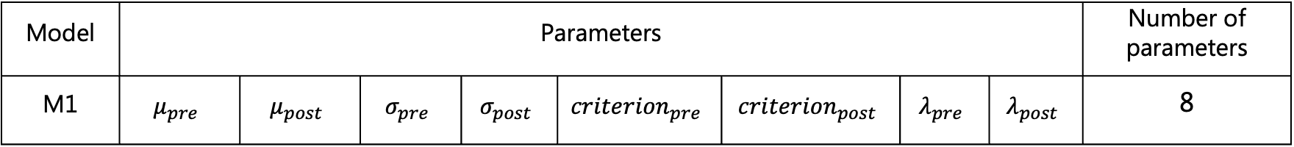
Model-free psychometric function fitting
“model-free” means data were fitted by the full model with 8 parameters
Fitting range:
lb = [-250, -250, 10, 10, 10, 10, 1e-4, 1e-4];
ub = [250, 250, 350, 350, 350, 350, 0.06, 0.06];
Shade: 68% confidence interval of the bootstrapped PMF curves
Model | Parameters |  |  |  |  |  |  |  | Number of parameters
M1 | $$μ_{pre}$$ | $$μ_{post}$$ | $$σ_{pre}$$ | $$σ_{post}$$ | $${criterion}_{pre}$$ | $${criterion}_{post}$$ | $$λ_{pre}$$ | $$λ_{post}$$ | 8

Slide 2
Notes:
Sub1
Summary
All parameters are within the range
Mu: seldom change
Sigma: no change/decrease (ises: 4, 6, 7)
Criterion: no change, decrease(ises: 1, 2, 7)
Lambda: no change
Indiv session
Ses1: only criterion decreases
Ses5: only mu shift
Ses7: Sigma and criterion decreases

Slide 3
Notes:
Sub2
Summary
All parameters are within the range
Mu: seldom change
Sigma: around 200; all increase
Criterion: around 200; all decrease
Lambda: all increase
Indiv session

Slide 4
Notes:
Sub3
Summary
Nearly all post-criteria hit the boundary
Mu: change in the direction
Sigma: increase/small decrease or no change(5,6,9)
Criterion: all great increase
Lambda: small, nearly no change
Indiv session
3&6: shift is too huge to capture the effect

Slide 5
Notes:
Sub4
Summary
1 post-criterion hit the boundary;
pattern varies among sessions
Mu
Sigma: great increase (except ses4)
Criterion: increase (1, 2, 7, 8, 9)/decrease(3, 4, 5, 6)
lambda
Indiv session

Slide 6
Notes:
Sub5 (excluded)
Summary
Nearly all criteria and sigmas hit the boundary;
pattern varies among sessions
Mu
Sigma: increases and hit boundary
Criterion:
lambda
Indiv session

Slide 7
Notes:
Sub6
Summary
All parameters are within the range
Mu
Sigma: no change or random change
Criterion: increase
Lambda: no change
Indiv session
3: increase of mu and criterion
8
9

Slide 8
Notes:
Sub7
Summary
All parameters are within the range
Mu
Sigma: random small change
Criterion: random change
Lambda: random change
Indiv session
4
7

Slide 9
Notes:
Sub8
Summary
All parameters are within the range
Mu
Sigma: decrease
Criterion: random change
Lambda: random change
Indiv session
8: only mu and criterion

Slide 10
Notes:
Sub9
Summary
All parameters are within the range
Mu
Sigma: decrease
Criterion: random change
Lambda: random change
Indiv session
8: only mu and criterion

Slide 11
Notes:
Sub10
Summary
All parameters are within the range
Mu
Sigma: no change/random change
Criterion: no change/random change
Lambda: no change
Indiv session
8

Slide 12
Notes:
Across subjects: N/A
Within subjects: s-shape across adaptor soa

Slide 13
Notes:
Across subjects: 1 decrease, 3 increase, 4 no change
Within subjects: no clear trend

Slide 14
Notes:
Across subjects: 1 decrease, 2 increase, 5 no change
Within subjects: no clear trend

Slide 15
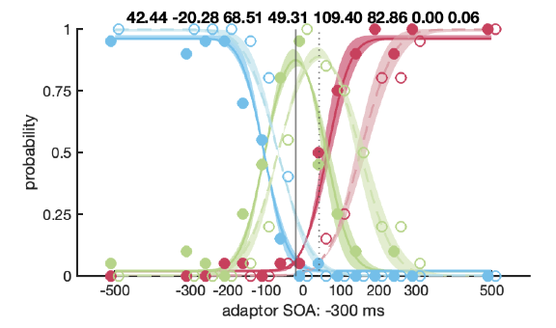
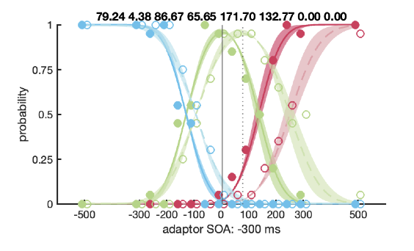
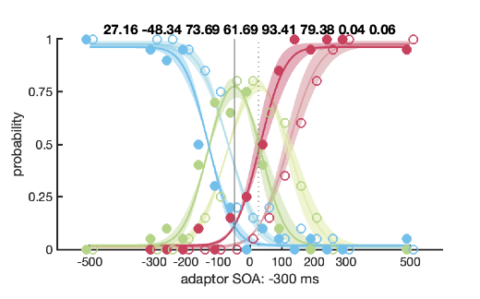
Notes:
7,7
1,8
9,1

